Slide 1
UNDERSTANDING REQUEST, RESPONSE AND SERVER OBJECTS
-NAME:CH.SUSHMITHA
ROLL NO:22H51A05M7

Slide 2
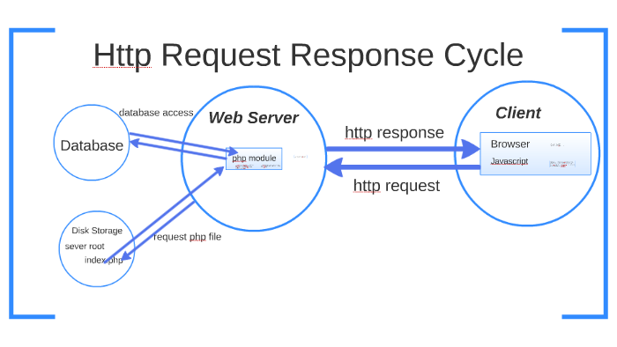
INTRODUCTION
Understanding the fundamental concepts of web communication is essential for effective web development.
The Request, Response, and Server objects play crucial roles in the client-server architecture.
Request, response, and server objects are part of the request-response model, which is used in many network protocols and systems to exchange information between clients and servers.
Notes:
Image source: http://bteccomputing.co.uk/request-response-model/

Slide 3
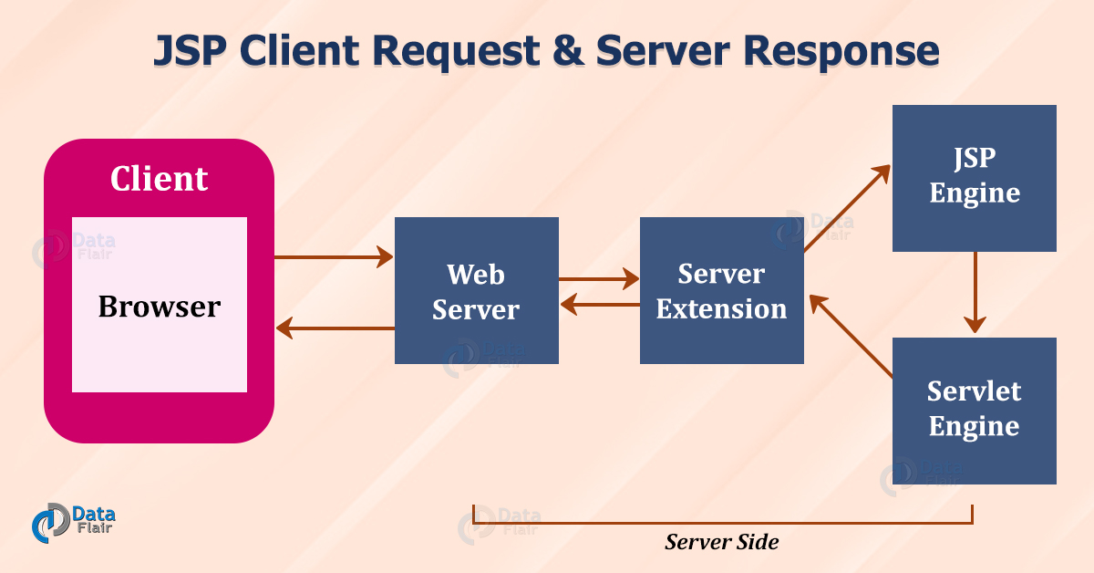
REQUEST OBJECT
The Request object represents the client's request to the server.
It contains information such as headers, query strings, and form data submitted by the client.
Developers use the Request object to retrieve and manipulate data sent by the client.
Notes:
Image source: https://oakwood.cuhkemba.net/blogs/jsp-client-request-server-response/

Slide 4
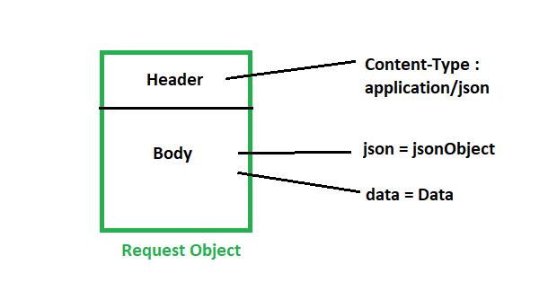
PROPERTIES
The Request object includes properties like URL, method, and body.
These properties allow developers to access specific details about the incoming request.
Understanding these properties is essential for processing client data effectively.
In JavaScript, fetch API can be used to construct a request object by specifying the URL, method, headers, and body.
Notes:
Image source: https://www.geeksforgeeks.org/python-requests-post-request-with-headers-and-body/

Slide 5
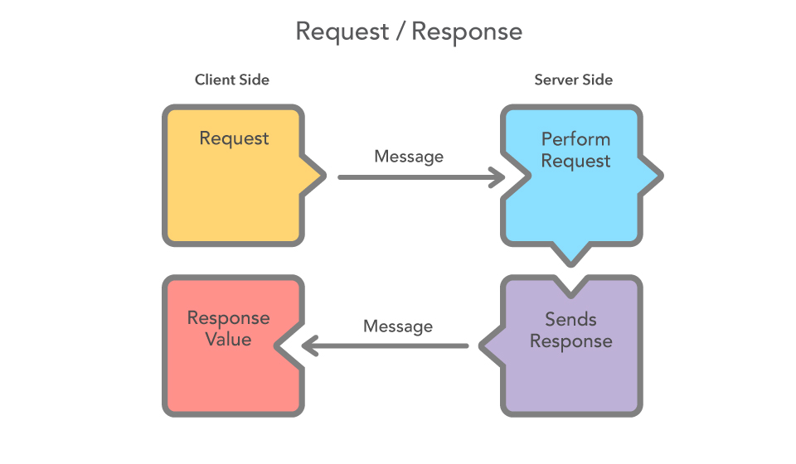
RESPONSE OBJECT
The Response object is used to send data back to the client after processing a request.
It contains methods and properties to set HTTP status codes, headers, and response body content.
Developers utilize the Response object to control what information is sent to the client.
Notes:
Image source: https://vanilla-java.github.io/2016/05/17/Modelling-Microservice-Patterns-in-Code.html

Slide 6
RESPONSE OBJECT METHODS
Common methods of the Response object include send(), json(), and redirect().
These methods facilitate various types of responses, from simple text to complex JSON data.
Mastering these methods allows developers to create dynamic web applications.
Notes:
Image source: https://datagy.io/python-requests-response-object/

Slide 7
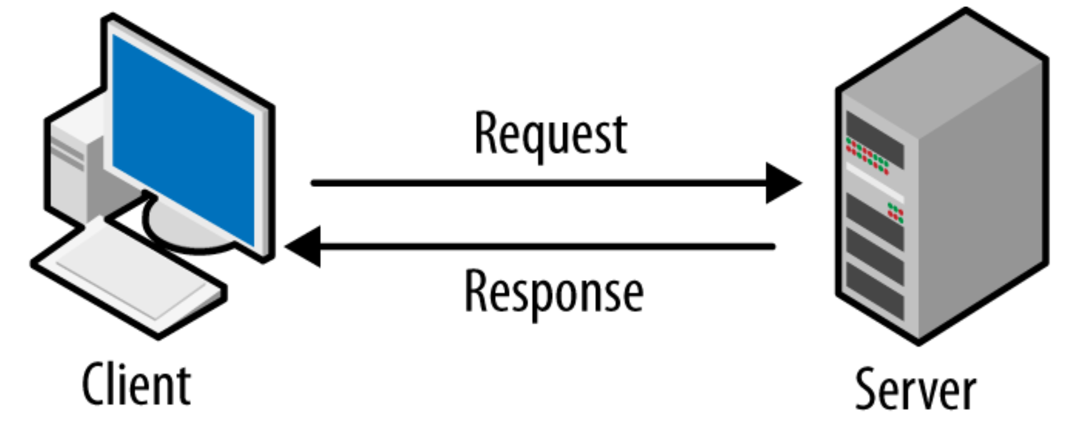
SERVER OBJECT
The Server object provides methods and properties for server-side operations.
It allows developers to perform tasks such as session management and application-level configurations.
Understanding the Server object is crucial for creating robust server-side applications.
Notes:
Image source: https://darvishdarab.github.io/cs421_f20/docs/readings/client_server/

Slide 8
SERVER OBJECT FUNCTIONS
The Server object includes functions like createObject(), mapPath(), and transfer().
These functions enable server-side scripting to handle various operations efficiently.
Proper use of the Server object enhances the overall performance of web applications.
Notes:
Image source: https://www.educba.com/sql-server-functions/

Slide 9
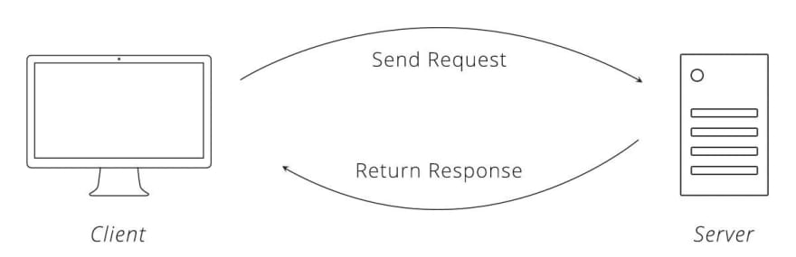
INTERACTION BETWEEN REQUEST AND RESPONSE
The Request and Response objects work together to facilitate data exchange between the client and server.
The server processes the Request object and generates a corresponding Response object.
This interaction is fundamental for the functionality of dynamic web applications.
Notes:
Image source: https://dev.to/jsmates/how-the-client-request-and-server-response-cycle-works-452o

Slide 10
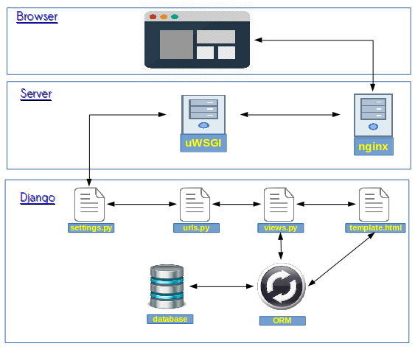
CONCLUSION
Understanding Request, Response, and Server objects is vital for effective web development.
Mastery of these components enhances the ability to create dynamic, responsive applications.
By applying best practices, developers can ensure secure and efficient web communication.
Notes:
Image source: https://django-easy-tutorial.blogspot.com/2017/03/django-request-lifecycle.html

Slide 11
THANK YOU

